Slide 1

High Impact Skills Development Program
in Artificial Intelligence, Data Science, and Blockchain
Module 8: Object Detection & Recognition Using CNN
Lecture 2: Fundamentals of Image Classification
Instructor: Ahsan Jalal

Slide 2
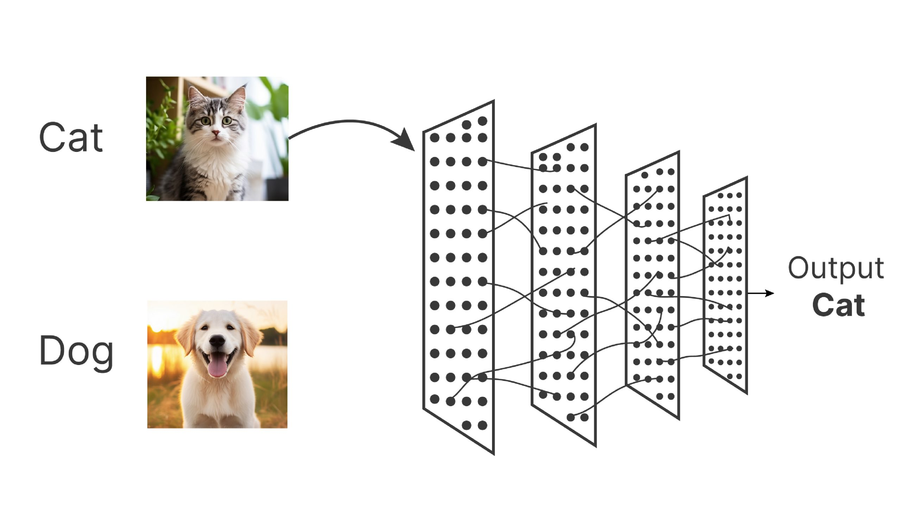
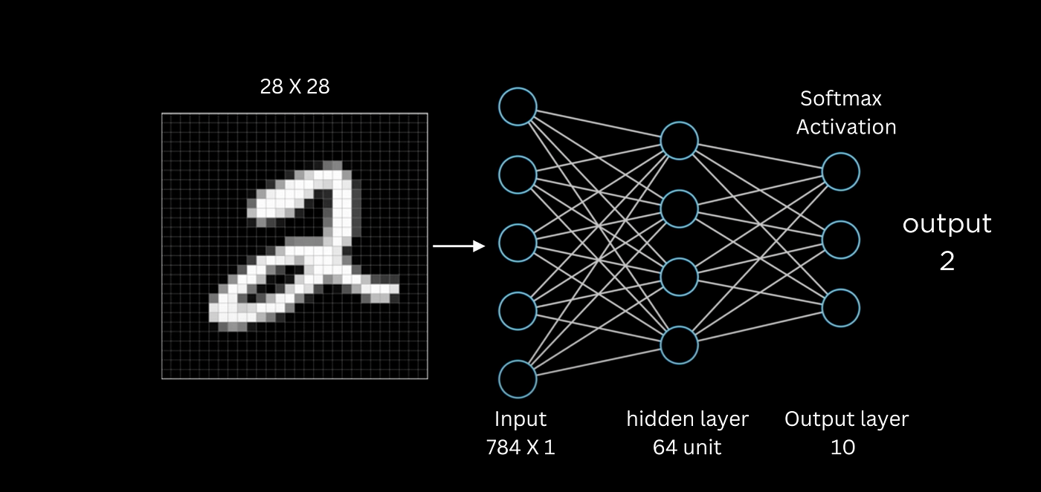
What is Image Classification
Task of assigning label to an image from predefined set of categories
Cats Vs Dogs, Handwritten digit recognition (MNIST), etc.

Slide 3
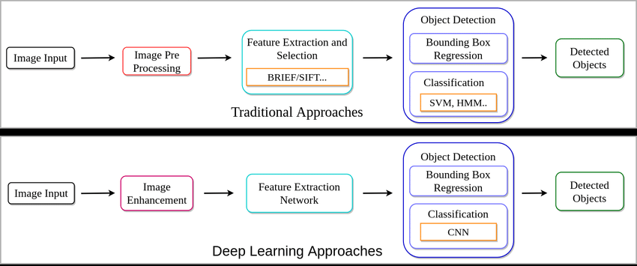
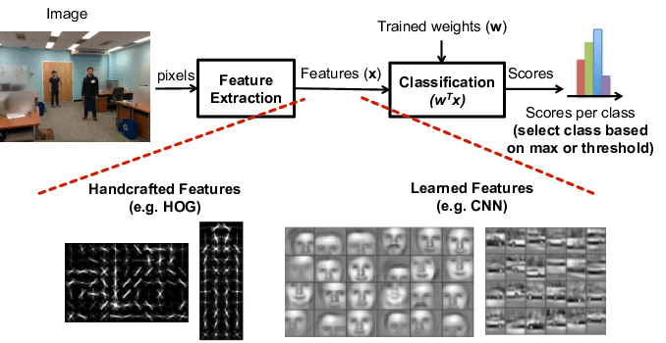
Why use CNN for Classification?
Traditional Methods: Feature extraction using edge detection, color histograms, etc.
Challenges: Manual feature extraction and limited generalization.
Advantages of CNNs:
Automatically learn spatial hierarchies of features (edges, textures, patterns).
Reduced need for manual feature extraction.
Scalability for larger datasets.

Slide 4

Overview of Convolutional Neural Networks (CNNs)
A class of deep neural networks designed specifically for processing structured grid data like images.
CNNs consist of layers that apply convolutions followed by non-linearities (activation functions).
Convolutional layers, pooling layers, fully connected layers.

Slide 5
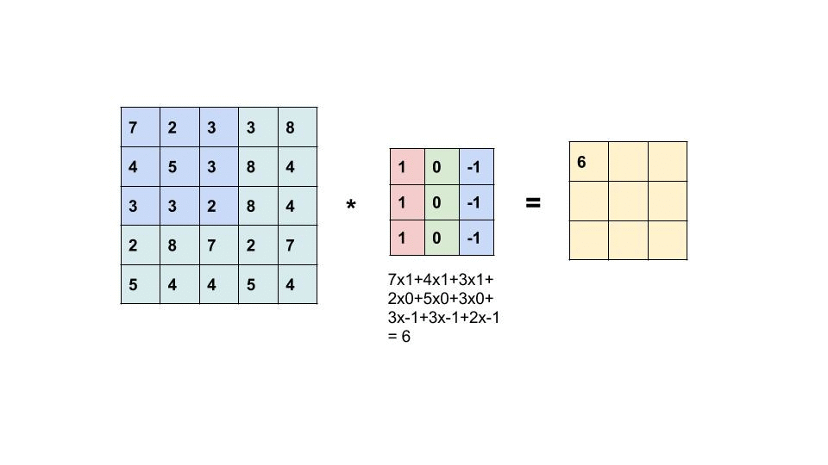
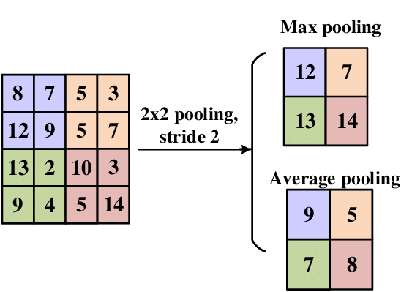
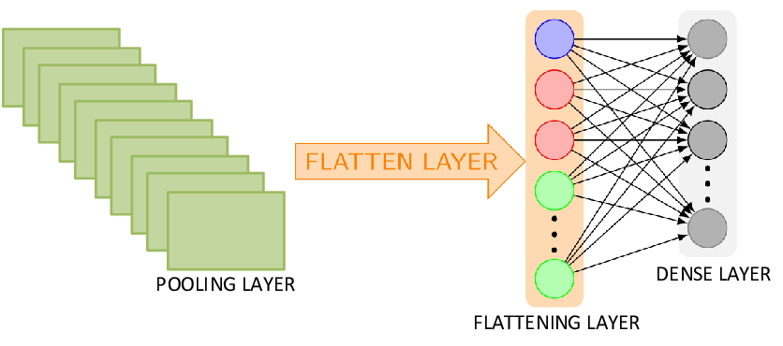
Basic Components of CNNs
Convolution Layer:
Detects spatial hierarchies in the image.
Uses filters (kernels) to slide over the image and produce feature maps.
Pooling Layer:
Reduces the dimensionality of the feature maps.
Retain dominant features
Max Pooling (most common), Average Pooling.
Fully Connected Dense Layer
Converts the final feature map into a classification score.
Each neuron is connected to every neuron in the previous layer.

Slide 6
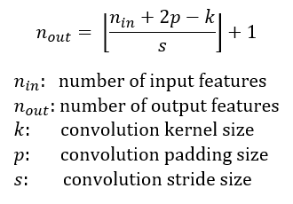
Calculating Output size
Formula to calculate Output Feature map size

Slide 7
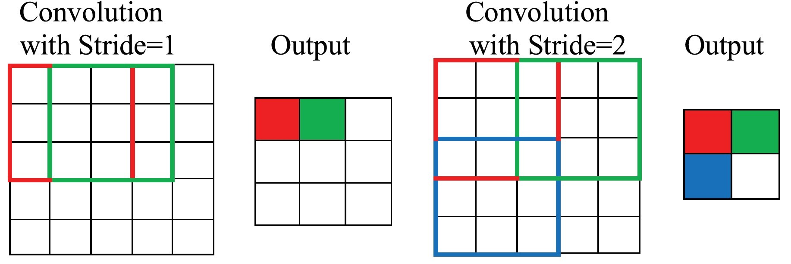
Stride
Effect of Stride

Slide 8
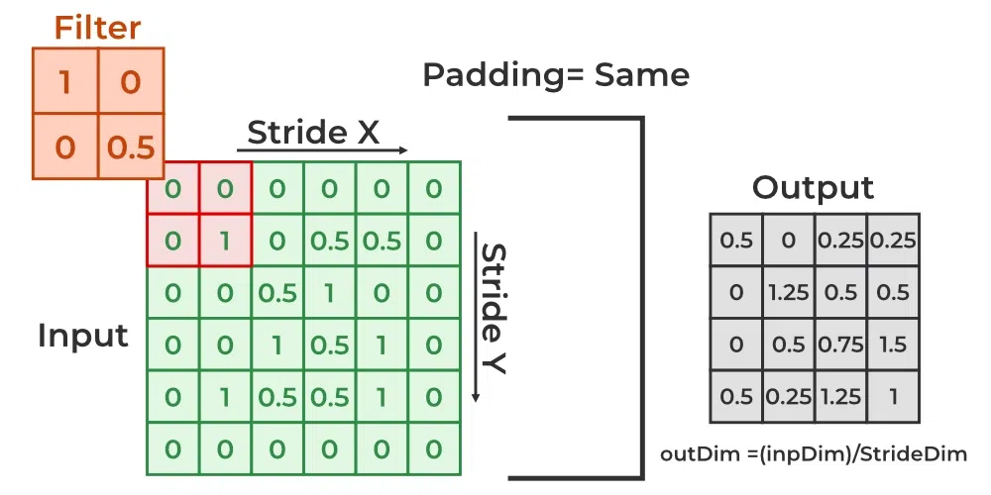
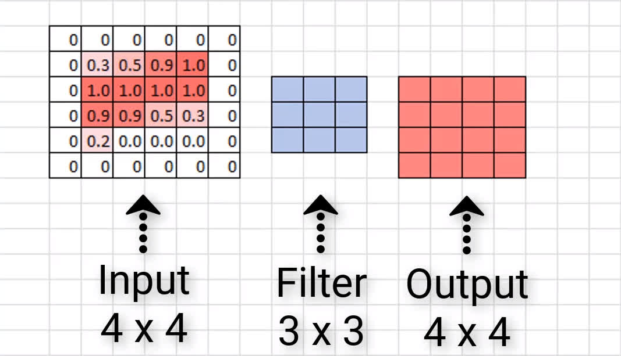
Padding
Padding is used to match input feature map size

Slide 9
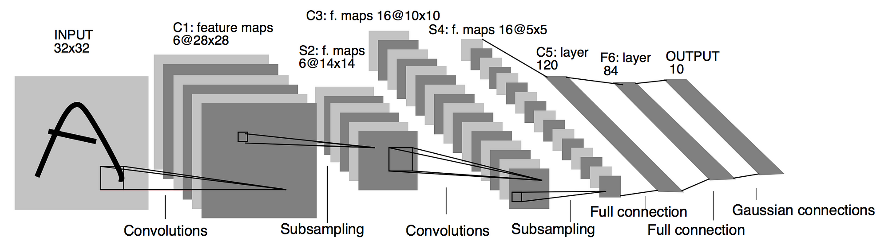
CNN Architecture Example
LeNet-5: One of the first successful CNN architectures.
Input: 32x32 grayscale image.
Two convolutional layers with activation functions (ReLU/Sigmoid).
Two subsampling (pooling) layers.
Fully connected layers.
Output: 10-class softmax for digit classification

Slide 10
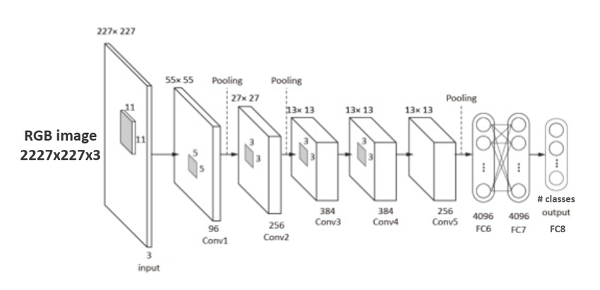
Modern CNN Architectures
AlexNet (2012):
Introduced deeper networks and ReLU activation.
Use of dropout for regularization.
Won the ImageNet competition.

Slide 11
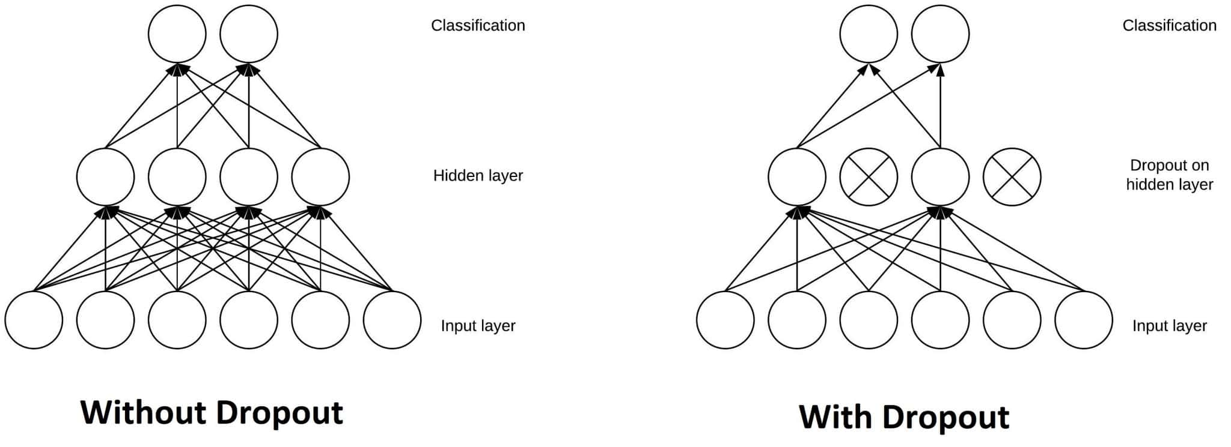
Introduction to Dropout
Dropout is a regularization technique that randomly sets neurons to zero during training.
To prevent overfitting by reducing the dependence of the model on any individual neuron.
Improved generalization performance, reduced computational cost, and easier hyperparameter tuning.

Slide 12
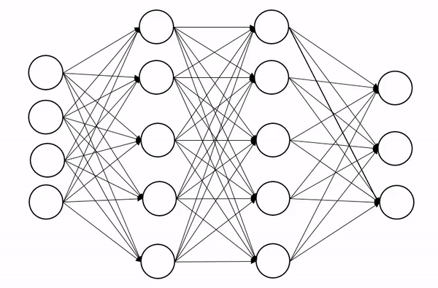
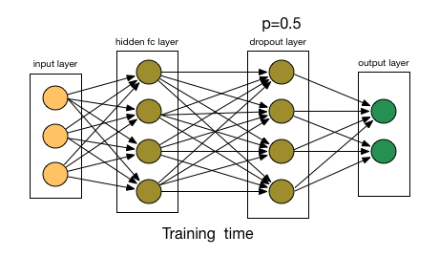
How Dropout Works ?
At each training iteration, a random subset of neurons is deactivated.
The network's output is computed with the activated neurons.
Gradients are calculated and updated for the active neurons during backpropagation.
The probability of a neuron being deactivated [0.2 – 0.5 often used] called Dropout Rate.
During Test: Scaling the activations of all neurons in each layer during testing to compensate for the dropout effect.

Slide 13
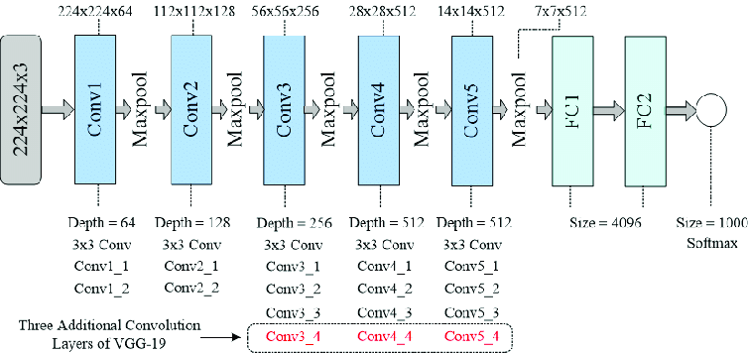
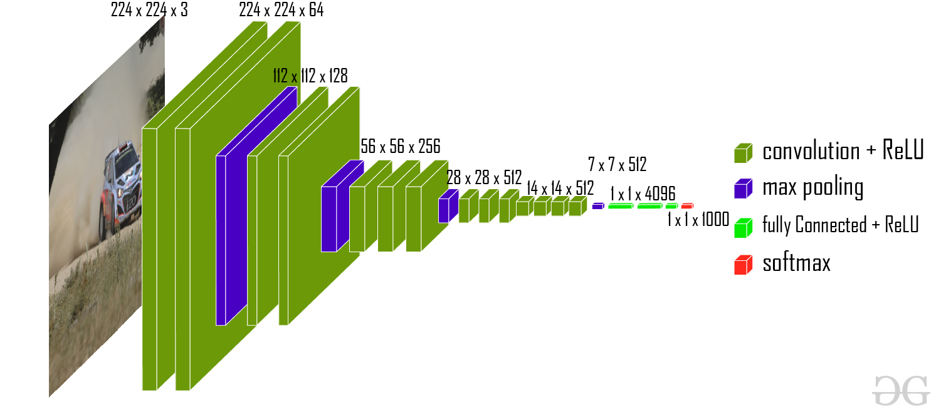
Modern CNN Architectures
VGGNet (2014):
Known for its simplicity: 3x3 filters and deep structure.
VGG-16 and VGG-19 models

Slide 14
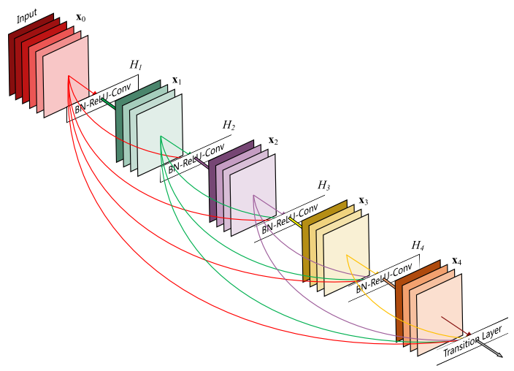
Modern CNN Architectures
ResNet (2015):
Introduced skip connections (residual connections).
Solved the vanishing gradient problem, enabling very deep networks
ImageNet winner.
ResNet-18, ResNet-34, ResNet-50, ResNet-101, ResNet-152

Slide 15
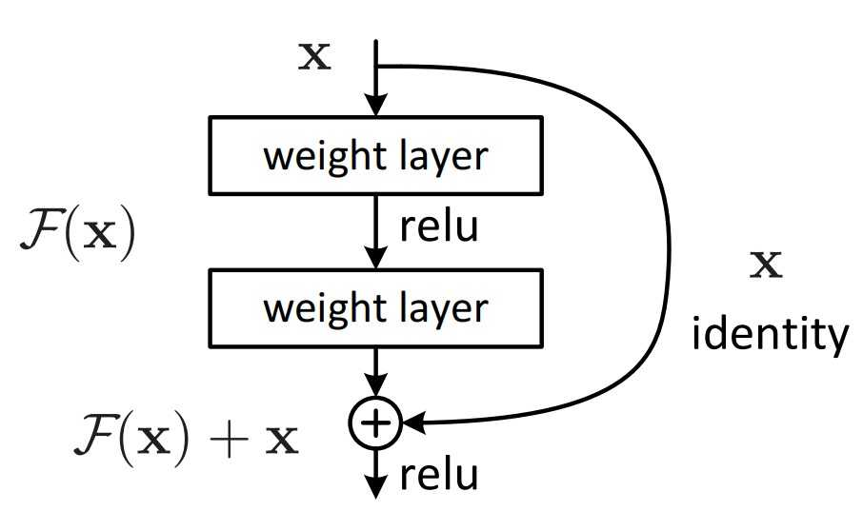
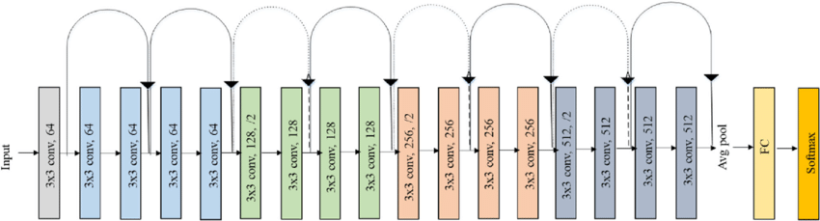
Residual/Skip Connections
A shortcut connection that bypasses some layers and adds the original input to the output.
Residual Block:
A residual block typically consists of two or more convolutional layers followed by a shortcut connection.
Advantages: Skip connections allow the gradient to flow directly from earlier layers to later layers, bypassing intermediate layers. This helps to prevent the vanishing or exploding gradient problem.

Slide 16
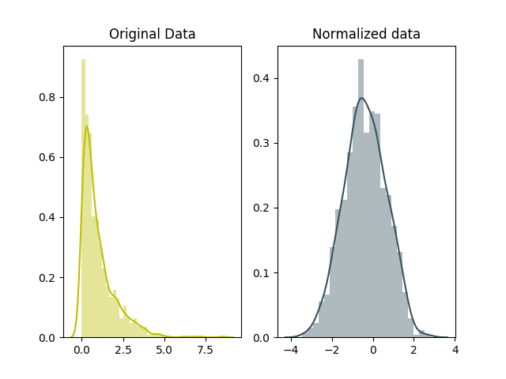
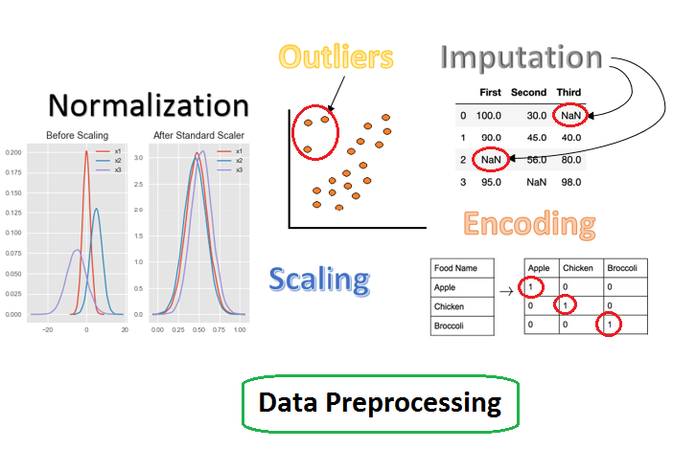
Data Preprocessing
Preparing raw data for machine learning models by cleaning and transforming it into a suitable format.
Pros:
Enhances model performance.
Reduces overfitting by improving generalization.
Improves model training speed.
Scaling, normalization, handling missing data, and data augmentation.

Slide 17
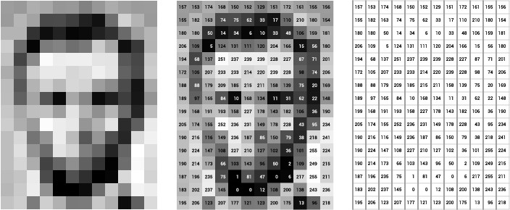

Why Data Preprocessing
Challenges in Raw Data:
Noise: Unwanted data variations.
Imbalanced data: Classes with different sample sizes.
Missing values: Incomplete data.
Varying scales: Features with different value ranges.

Slide 18
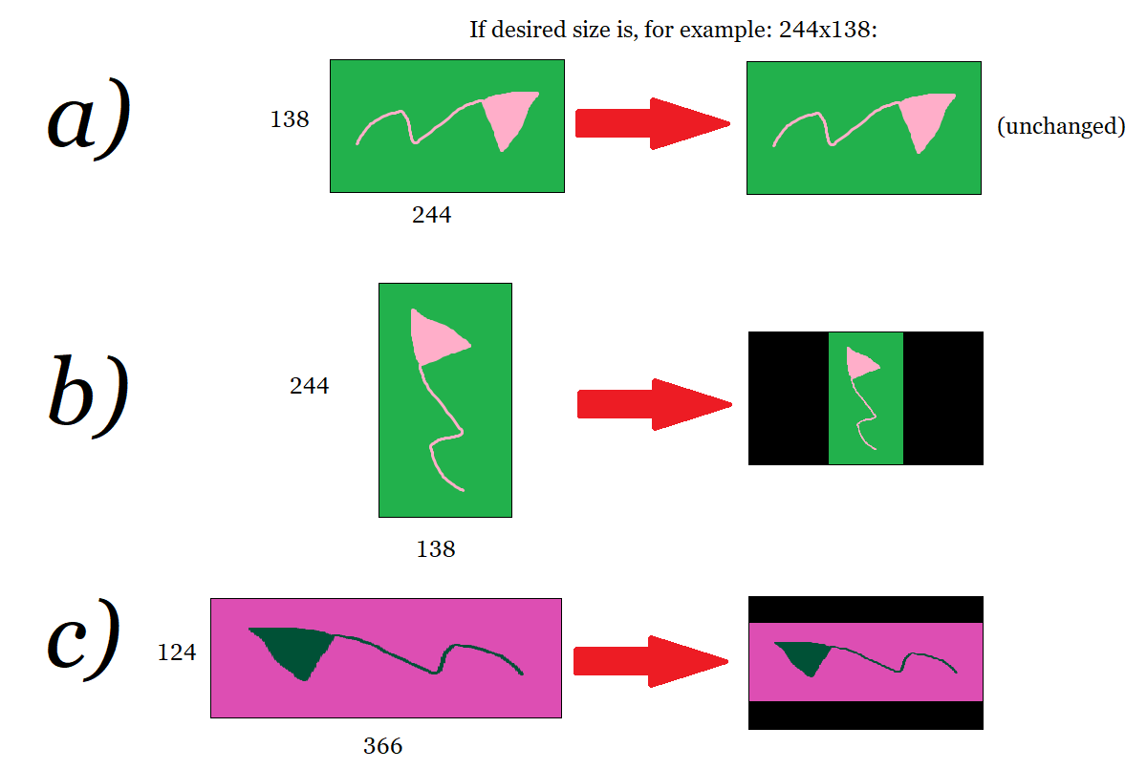
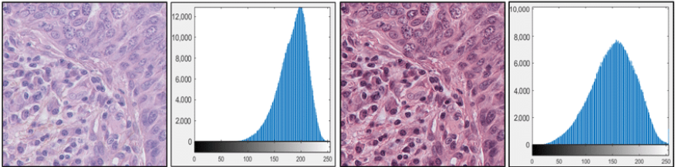
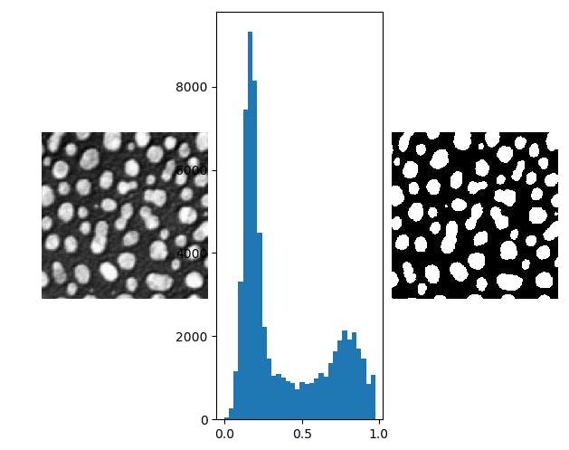
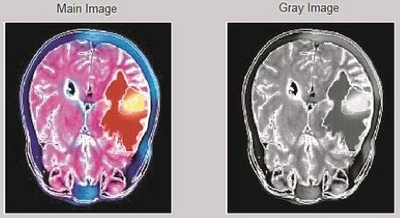
Data Preprocessing Techniques for Images
Resizing:
Why? Ensures all images have the same dimensions for uniformity in input size.
Resizing all images to 224x224 for input into a CNN like VGG16.
Normalization:
Why? Converts pixel values to a common scale, typically [0, 1] or [-1, 1].
Formula: (X - min) / (max - min)
Normalize pixel values from 0-255 to 0-1.
Grayscale Conversion:
Simplifies image data by reducing color channels, useful in specific tasks (e.g., medical imaging)
Image Binarization:
Thresholding images to separate objects from the background.
Black and white conversion for simple shape detection.

Slide 19
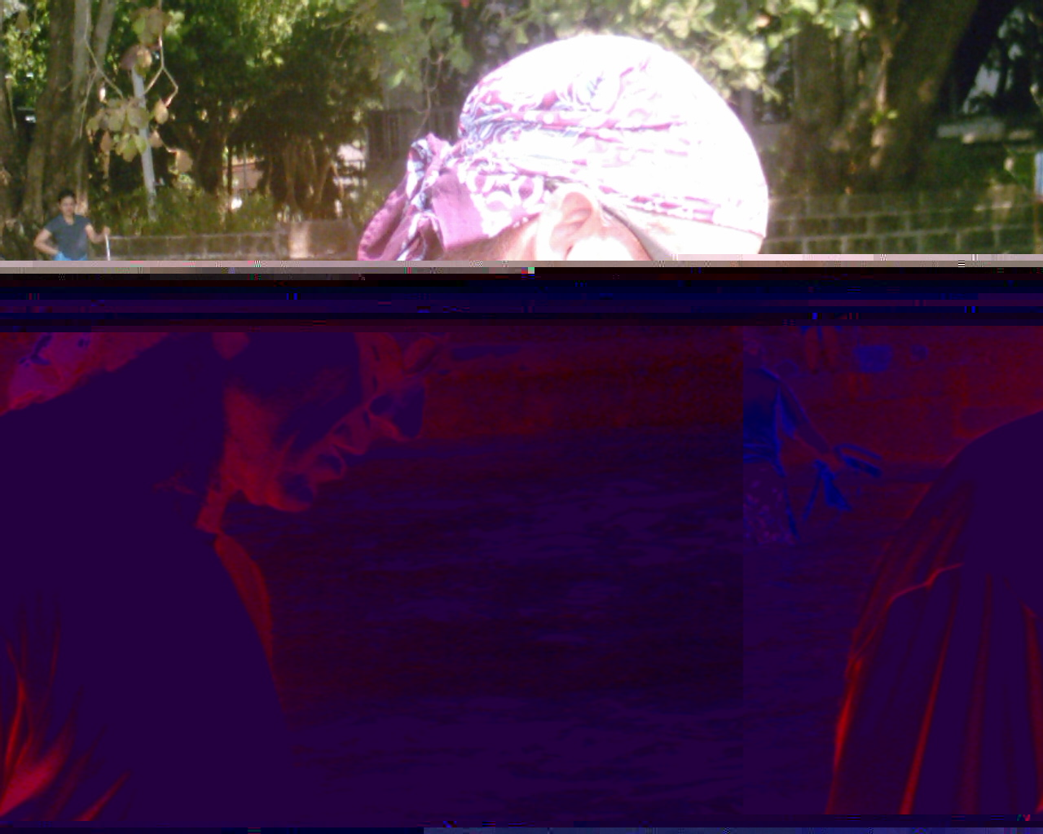
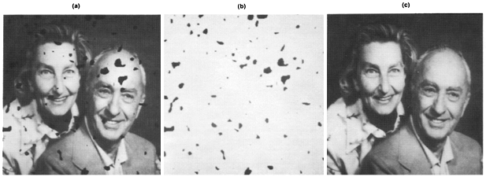
Data Cleaning
Handling Missing or Corrupted Data:
Remove or Fill: Removing corrupt images or filling missing values using interpolation techniques.
Common Approaches: Use median, mean, or nearest neighbors to fill missing pixel values.
Usage: Detecting and removing images with unreadable pixel values.

Slide 20
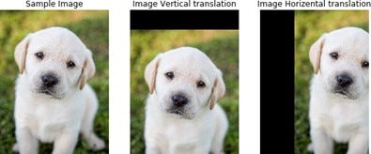
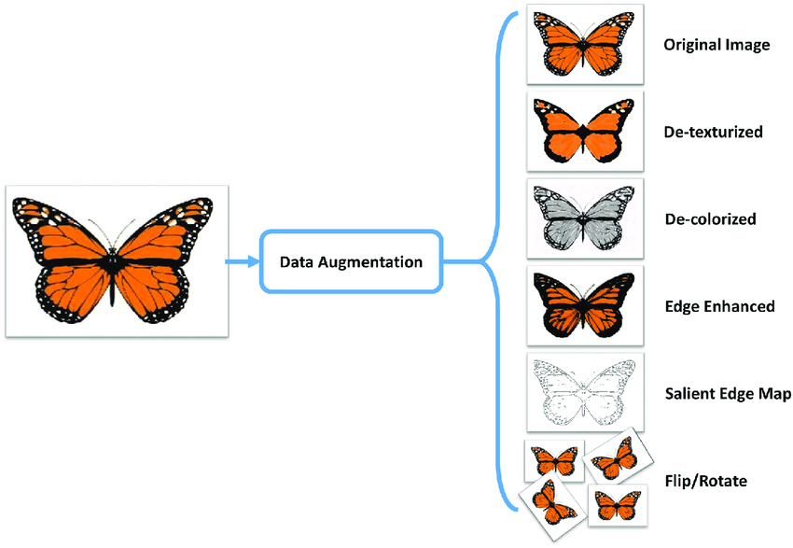
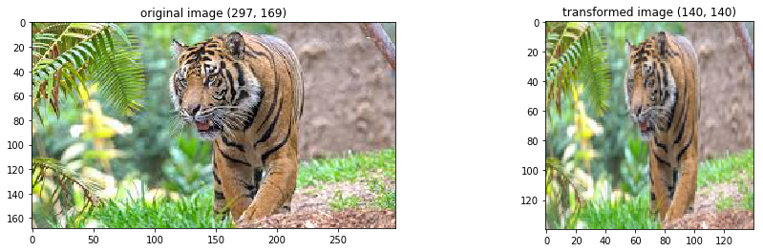
Data Augmentation
Artificially increasing the size and diversity of a dataset by applying transformations.
Improve model generalization and reduce overfitting, especially when data is limited.
When to Use: Small datasets, overfitting, or to introduce variations to improve robustness.
Common Types:
Horizontal & Vertical Flip
Rotation
Translation
Scaling

Slide 21
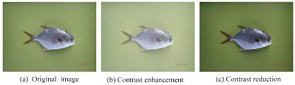
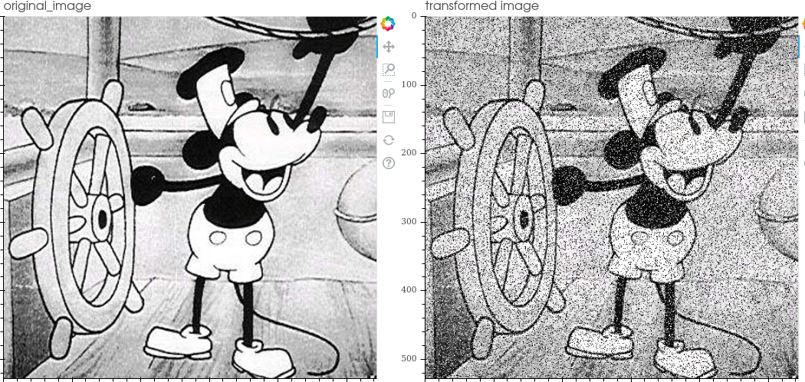
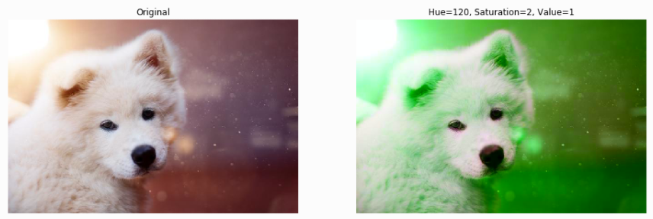
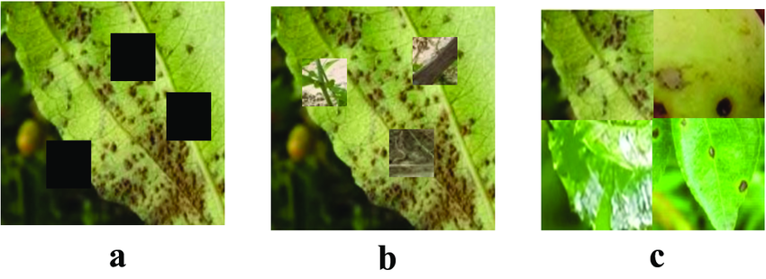
Advanced Augmentation Techniques
Brightness and Contrast Adjustment:
Simulates lighting variations in real-world scenarios.
Underwater fish dataset, Street signs in Day/Night conditions, etc.
Noise Injection:
Introduces random pixel noise to make the model robust to noise in real-world data.
Add Gaussian noise to simulated camera artifacts
Color Jittering:
Randomly changes the hue, saturation, and brightness to simulate various lighting conditions.
Color jittering in forest images for different lighting
Conditions
Cutout (or Random Erasing):
Randomly erases part of the image to force the model to focus on different areas.
Coutout, cutmix, mosaic, etc.

Slide 22
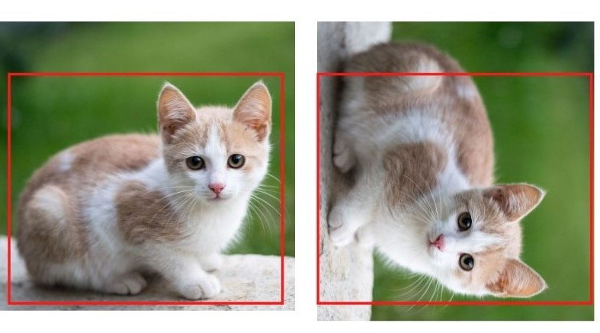
Augmentation for Image Classification vs Object Detection
Image Classification: Augmentation focuses on image-level changes (rotation, zoom, brightness, etc.)
Object Detection: Careful with transformations that distort object shapes or proportions. Use bounding-box aware augmentation techniques (e.g., YOLO-specific transformations).

Slide 23
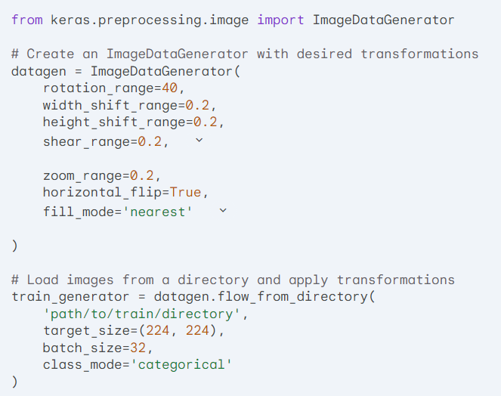
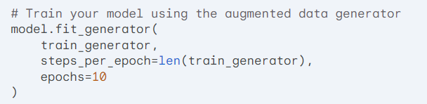
Augmentation Libraries and Tools
OpenCV: Offers basic transformations like rotation, translation, scaling.
Keras ImageDataGenerator: Provides on-the-fly augmentation during training.
Albumentations: Advanced augmentation library offering more control.

Slide 24
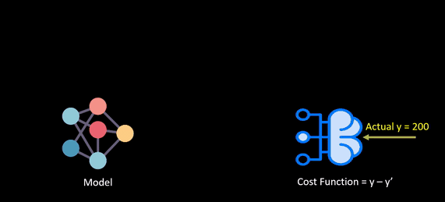
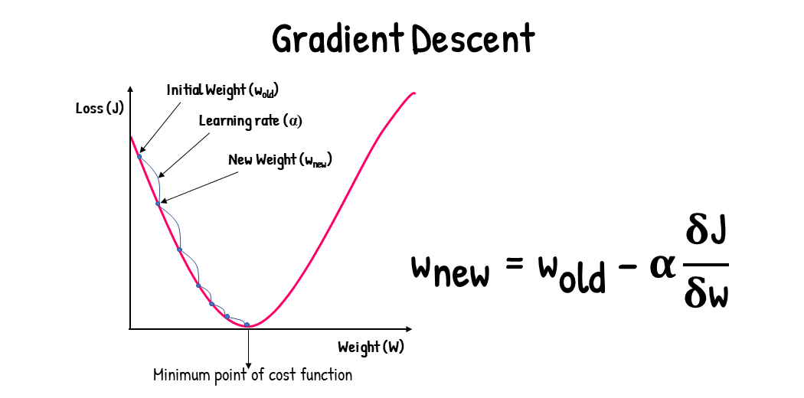
Loss/Cost Functions for Classification
Definition:
A function that measures how well a model's predictions match the true labels.
Purpose:
Guides the optimization process (e.g., gradient descent).
Quantifies the difference between predicted and actual outputs.
Types:
Classification, regression, and more.
Optimization: Loss function is minimized during training using optimization algorithms (like SGD or Adam).

Slide 25
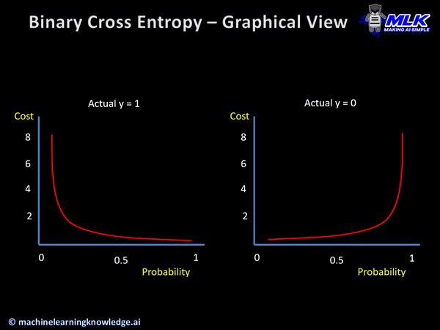
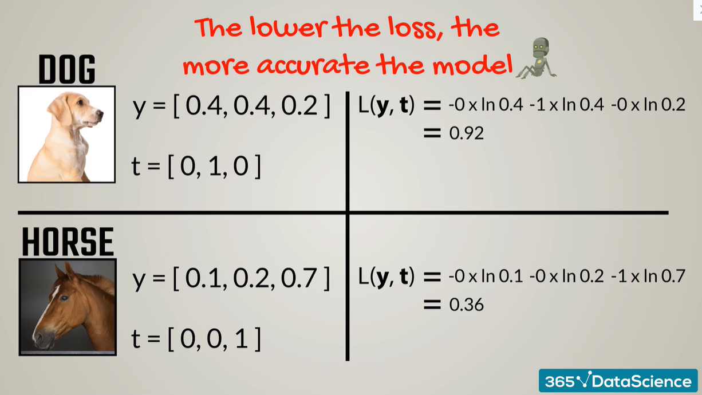
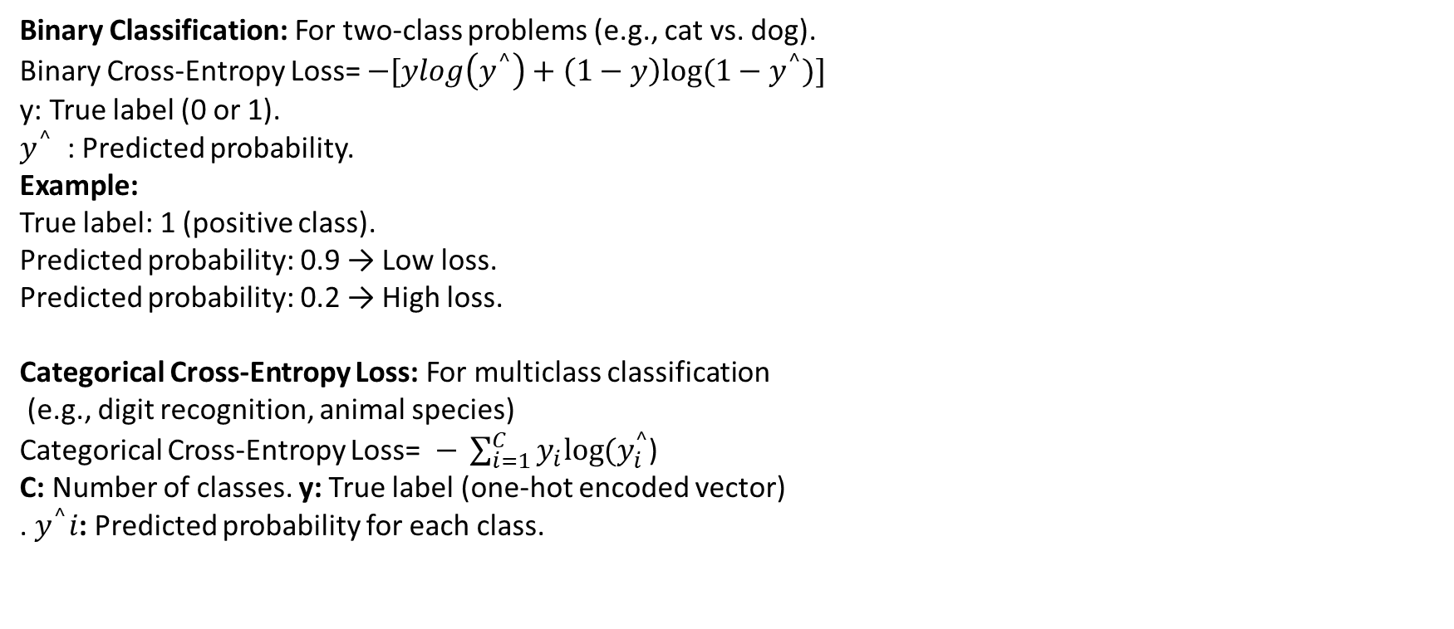
Loss Function for Classification
Binary Classification: For two-class problems (e.g., cat vs. dog).
Binary Cross-Entropy Loss= $−[ylog\left(y^{^}\right)+\left(1−y\right)log⁡(1−y^{^})]$
y: True label (0 or 1).
$y^{^}$​ : Predicted probability.
Example:
True label: 1 (positive class).
Predicted probability: 0.9 → Low loss.
Predicted probability: 0.2 → High loss.
Categorical Cross-Entropy Loss: For multiclass classification (e.g., digit recognition, animal species)
Categorical Cross-Entropy Loss=$− \sum_{i=1}^{C}{y_{i}log⁡(y_{i}^{^}}$)
C: Number of classes. y: True label (one-hot encoded vector) . $y^{^}i$​: Predicted probability for each class.

Slide 26
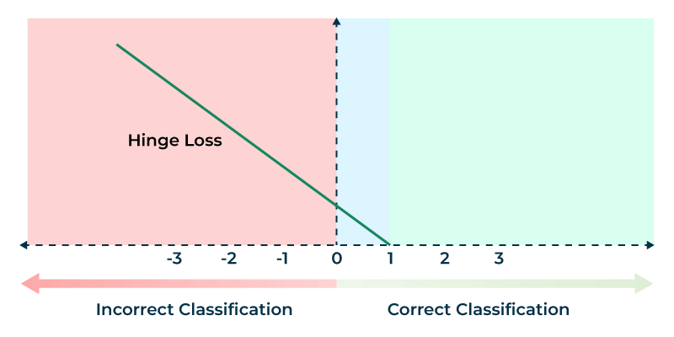
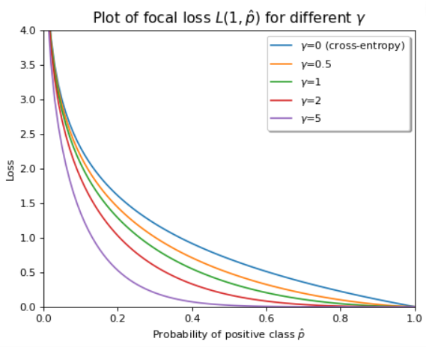
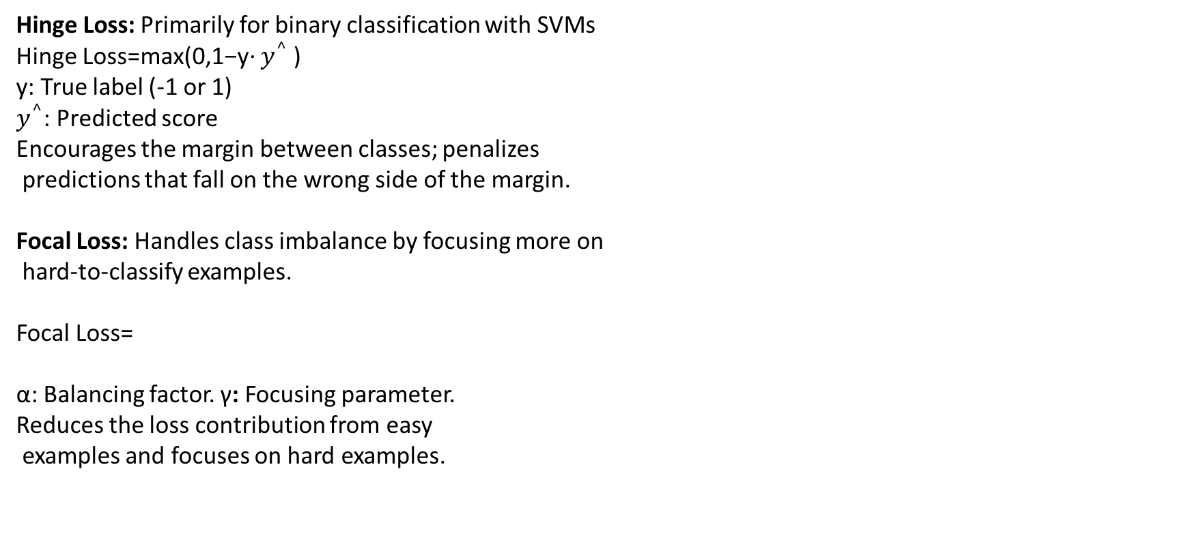
Loss Function for Classification
Hinge Loss: Primarily for binary classification with SVMs
Hinge Loss=max(0,1−y⋅ $y^{^}$​)
y: True label (-1 or 1)
$y^{^}$: Predicted score
Encourages the margin between classes; penalizes predictions that fall on the wrong side of the margin.
Focal Loss: Handles class imbalance by focusing more on hard-to-classify examples.
Focal Loss=
α: Balancing factor. γ: Focusing parameter.
Reduces the loss contribution from easy examples and focuses on hard examples.

Slide 27
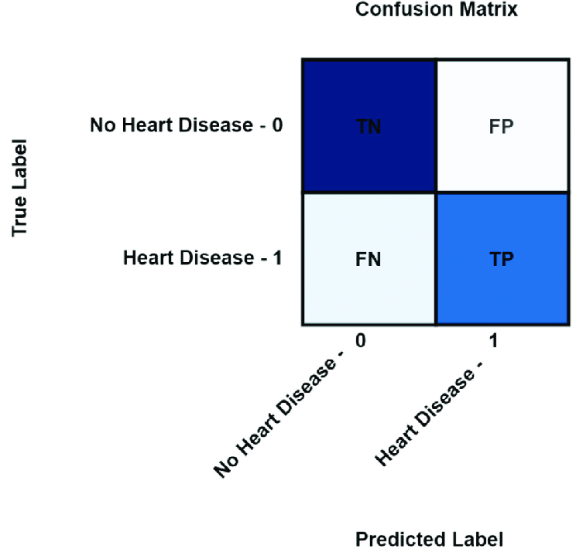
Evaluation Metrics
Metrics used to evaluate the performance of machine learning models.
Help in determining how well a model generalizes to unseen data.
Different metrics provide different insights, especially in cases of imbalanced datasets.
Confusion Matrix:
A matrix used to evaluate the performance of a classification algorithm.
True Positives (TP): Correctly predicted positive cases.
True Negatives (TN): Correctly predicted negative cases.
False Positives (FP): Incorrectly predicted positive cases (Type I error)
.False Negatives (FN): Incorrectly predicted negative cases (Type II error)

Slide 28
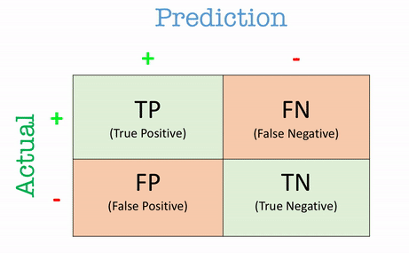


Accuracy
The proportion of correctly predicted observations to the total observations.
$$Accuracy=\frac{TP+TN}{TP+TN+FP+FN}$$
Problem with Imbalanced Datasets:
In a dataset where 95% of the data belongs to class A and 5% to class B, a model that predicts only class A will still have high accuracy.
Accuracy does not account for the imbalance between positive and negative classes.

Slide 29



Precision & Recall
Precision: The proportion of correctly predicted positive observations to all predicted positives.
$$Precision=\frac{TP}{TP+FP}$$
High precision indicates low false positive rates (important in spam detection, medical diagnosis).
Recall (Sensitivity): The proportion of correctly predicted positive observations to all actual positives.
$$Recall=\frac{TP}{TP+FN}$$
High recall is important when we want to capture as many positives as possible (e.g., disease screening).

Slide 30

Precision Vs. Recall
Trade off:
Precision is about being exact, while recall is about being comprehensive.
Often inversely related.
Example:
A spam classifier:
High precision: Few false positives, but may miss some spam emails (low recall).
High recall: Detects most spam, but may also mark some legitimate emails as spam (low precision).

Slide 31

How to Select the Threshold

Slide 32

How to Select the Threshold
Should we select a high threshold ? Or Low ?

Slide 33

How to Select the Threshold

Slide 34


F1 Score
The harmonic mean of precision and recall.
$$F1 Score=2 ×\frac{Precision×Recall}{(Precision+Recall)}$$
Useful when precision and recall are both important, especially in imbalanced datasets.

Slide 35

Specificity (True Negative Rate)
The proportion of correctly predicted negative observations to all actual negatives.
$$Specificity=\frac{TN}{TN+FP}$$
Important when false positives are costly (e.g., fraud detection).

Slide 36

ROC Curve (Receiver Operating Characteristic Curve)
A graph that shows the performance of a
classification model at all classification thresholds.
True Positive Rate (Recall) on the y-axis.
False Positive Rate (1 - Specificity) on the x-axis.

